Slide 1
COLLEGE BOT USING AI
Team Members
1.Anand S [711714104005]
2.Arul Kumar T [711714104011]
3.Divya U [711714104018]
4.Mohamed Sharuk CM [711714104033]
Guided by
Industry Mentor: Mr.Vasanth
Faculty Mentor: Ms. Poongothai. K
Department of CSE, KGiSL Institute of Technology, Coimbatore

Slide 2
Abstract
The College bot is built using artificial intelligence that analyses user’s queries and understand user’s message. Students and parents just have to query through the bot by chatting. Students can chat using text format. The System uses built in artificial intelligence to answer the query. The system provides answers as per user queries. The System analyses the question and then answers to the user. The user can query about admissions and its details.
Department of CSE, KGiSL Institute of Technology, Coimbatore

Slide 3
Area Introduction-Existing system
Chatbot is a computer program designed to simulate conversations with humans. The first chatbot, Eliza, was built in 1966 at the MIT Artificial Intelligence Laboratory by Joseph Weizenbaum to mimic human conversations. There are various chatbots already available such as Poncho (Messenger bot), Insomno bot (Chatting), Melody and Dr.AI. (Healthcare), Natasha (Messenger and chatting).
Department of CSE, KGiSL Institute of Technology, Coimbatore

Slide 4
Proposed System
College Bot using AI and machine learning which provides information about the college to the users.
Advantages over existing methods:
The College Bot gives detailed information about the college.
Future enhancement:
We will develop an open domain for every college in the city.
Department of CSE, KGiSL Institute of Technology, Coimbatore

Slide 5
Literature Review
Drawbacks of existing methods:
Lack of detailed information
Lack of the unavailability of NLP(Natural Language Processing)
References
IEEE
Elbot
Chatbot Magazines
Department of CSE, KGiSL Institute of Technology, Coimbatore

Slide 6
Data Flow Diagram Level 0
User
Chat Bot Application
Admin
Ask query
Update
Response
Department of CSE, KGiSL Institute of Technology, Coimbatore

Slide 7
Data Flow Diagram-Level 1
User
Ask query
Process Query
Search keywords
Response
Database
Query Output
Admin
Update Logs
Store updates

Slide 8
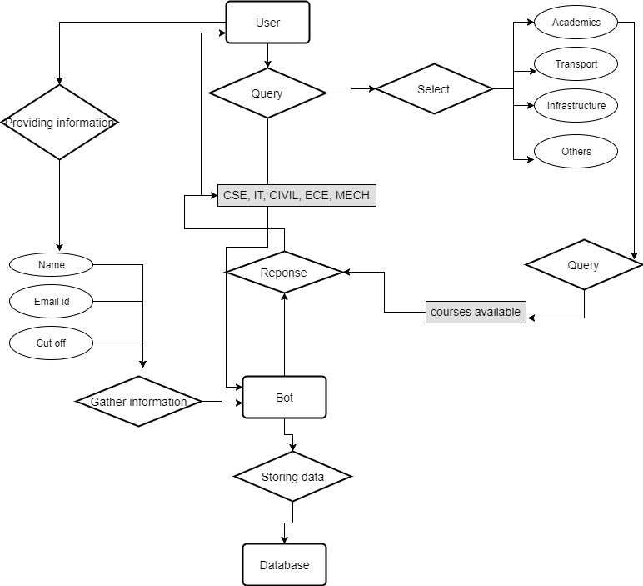
ER diagram

Slide 9
Module Splitup
Module 1 (Mohamed Sharuk CM)
-Tensor flow integration with python
-Framing Database Structure
Module 2 (Anand S)
-Bot creation using tensor flow
-Creating UI
Module 3 (Arul Kumar T)
-Implement NLP in the bot
-Train the bot
Module 4 (Divya U)
-Deploy the bot
-Handling Information Availability

Slide 10
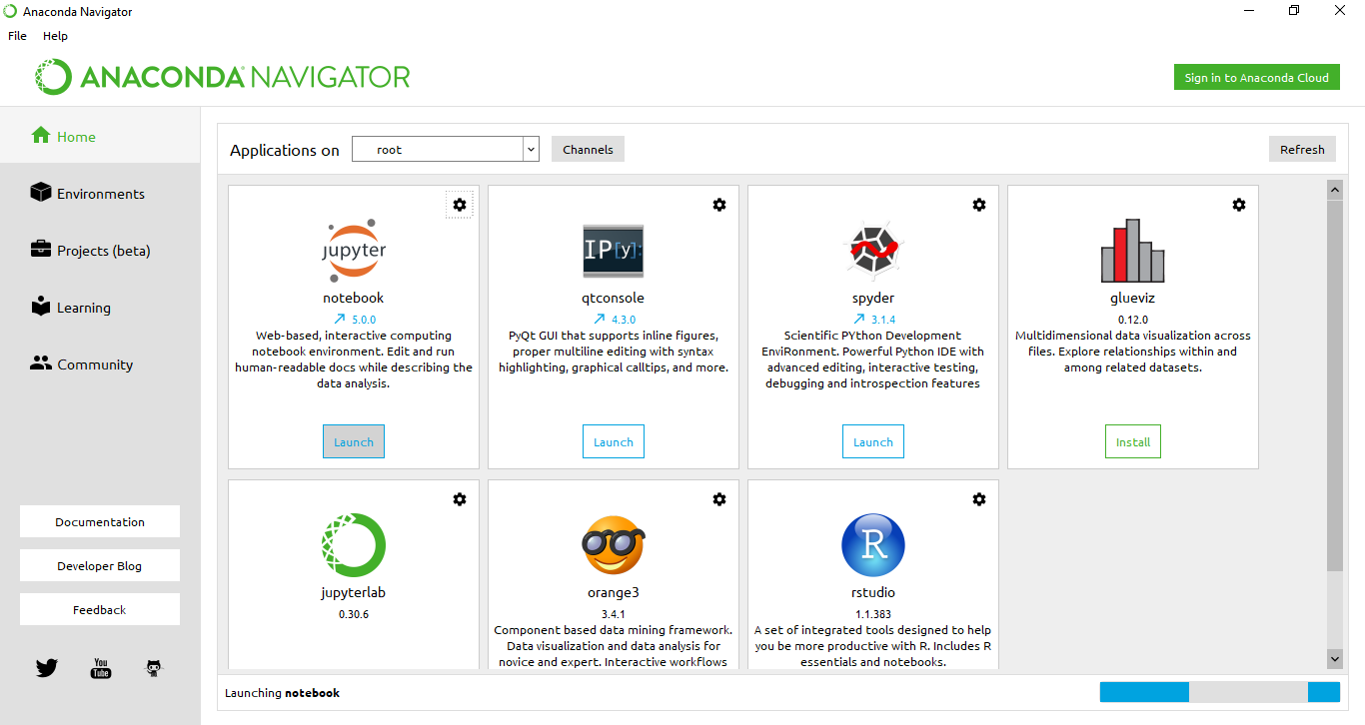
Screen shots of modules under progress.

Slide 11
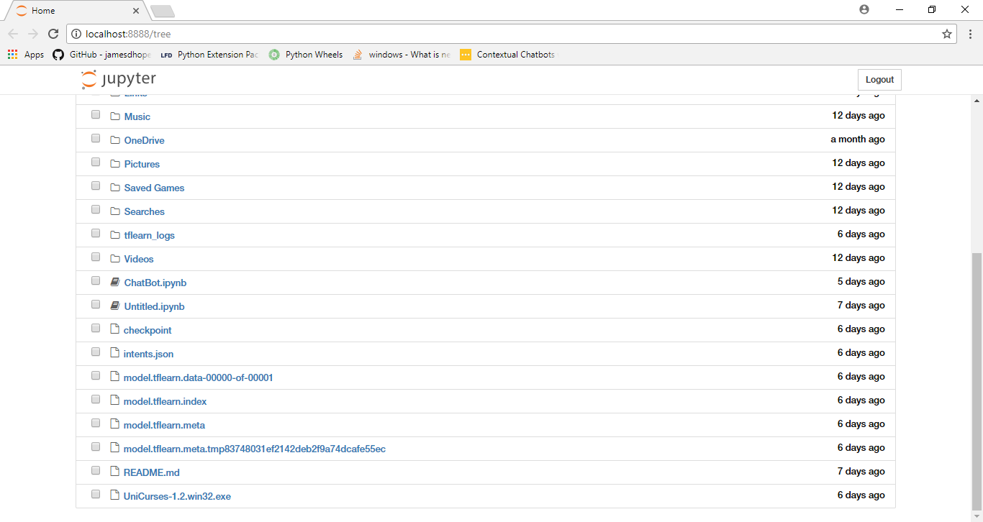
Continued...

Slide 12
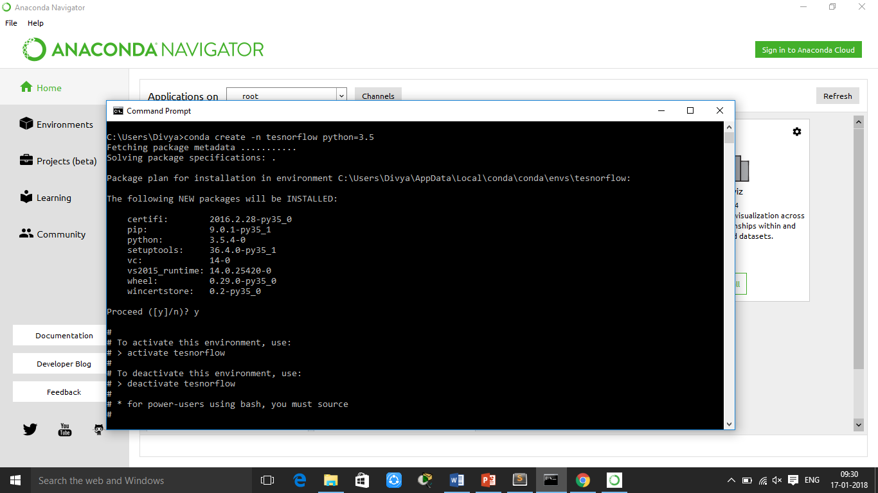
Continued...

Slide 13
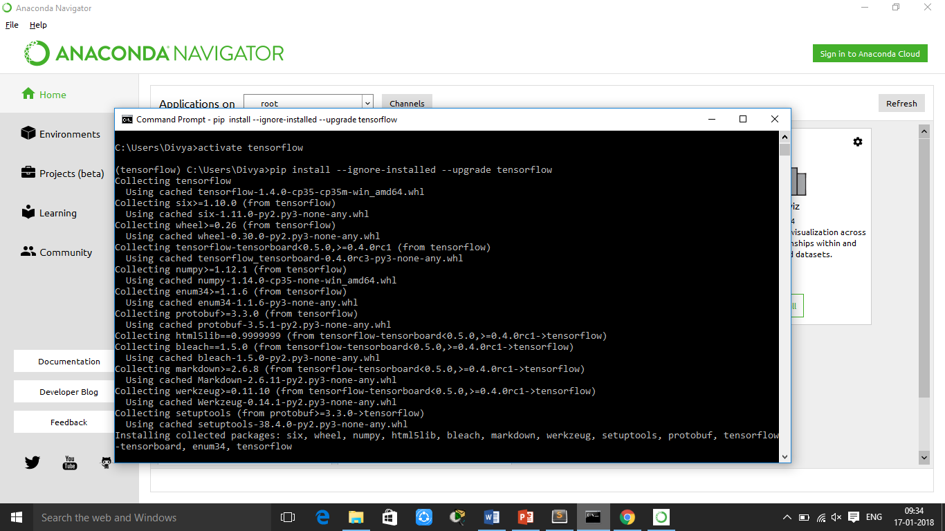
Continued...

Slide 14
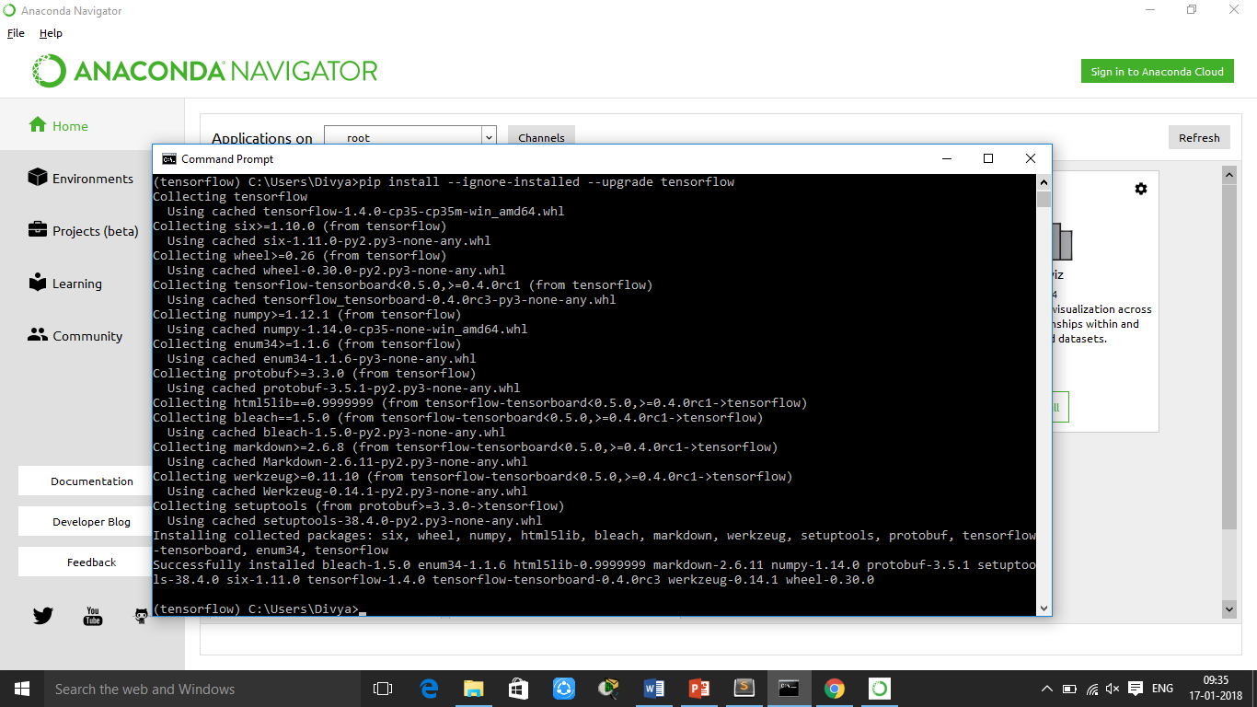
Continued...

Slide 15
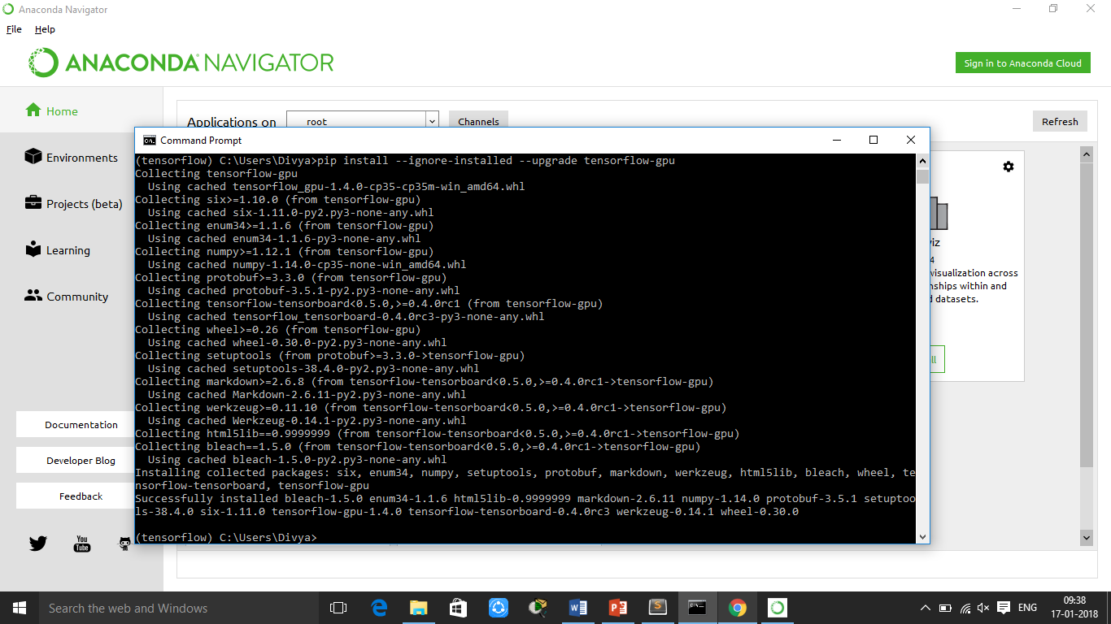
Continued...

Slide 16
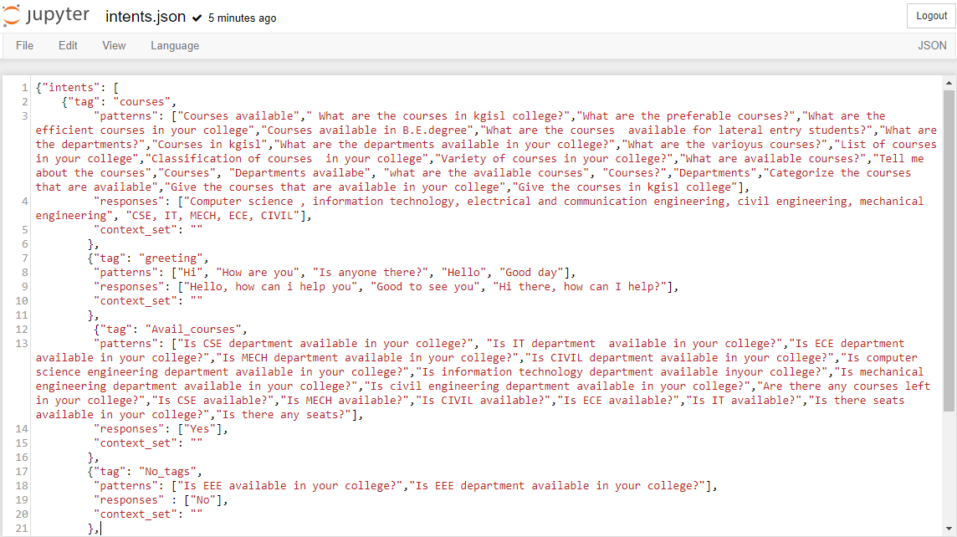
Continued...

Slide 17
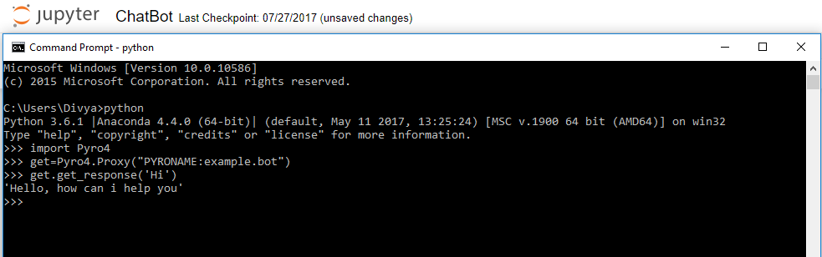
Continued..

Slide 18
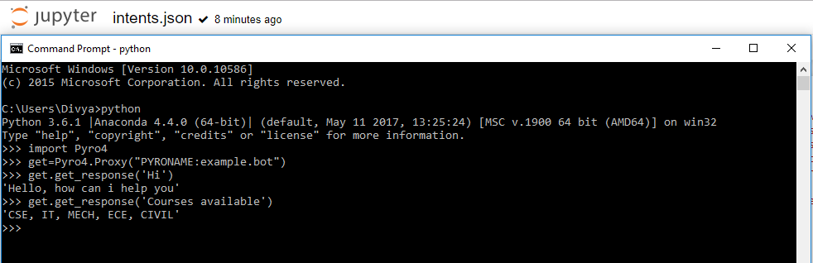
Continued…

Slide 19
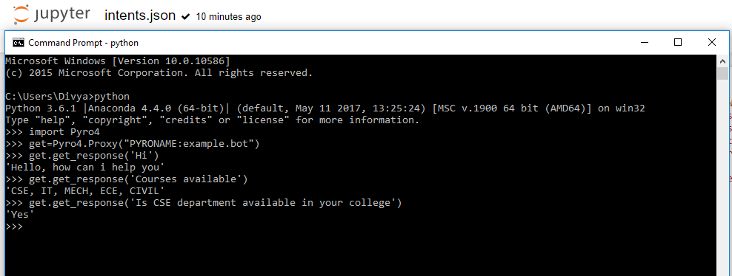
Continued….

Slide 20
Thank You

